Slide 1
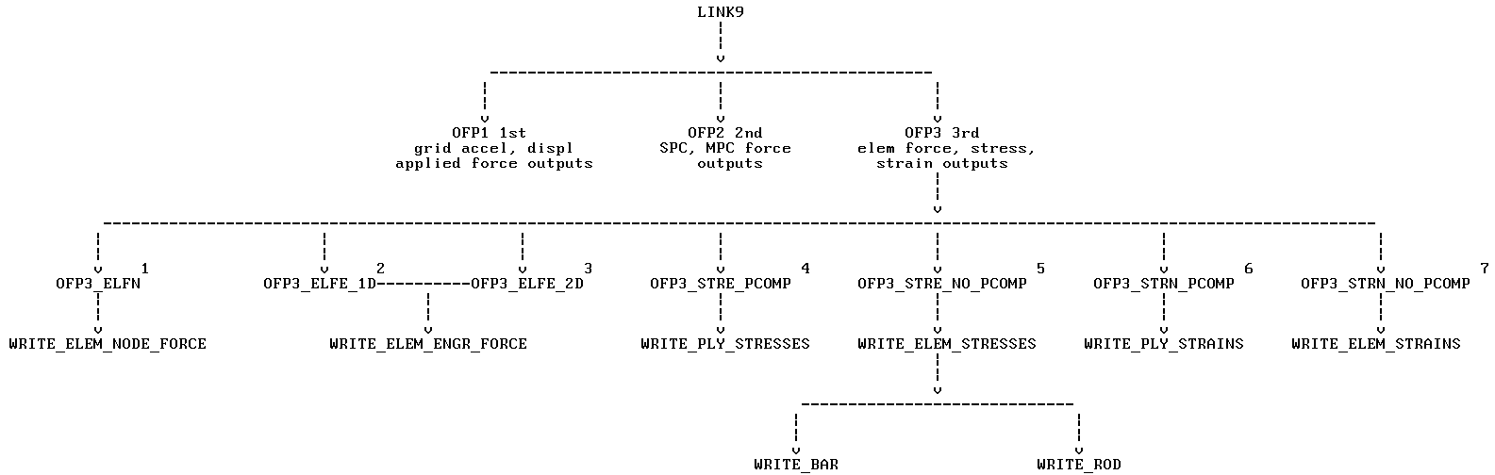
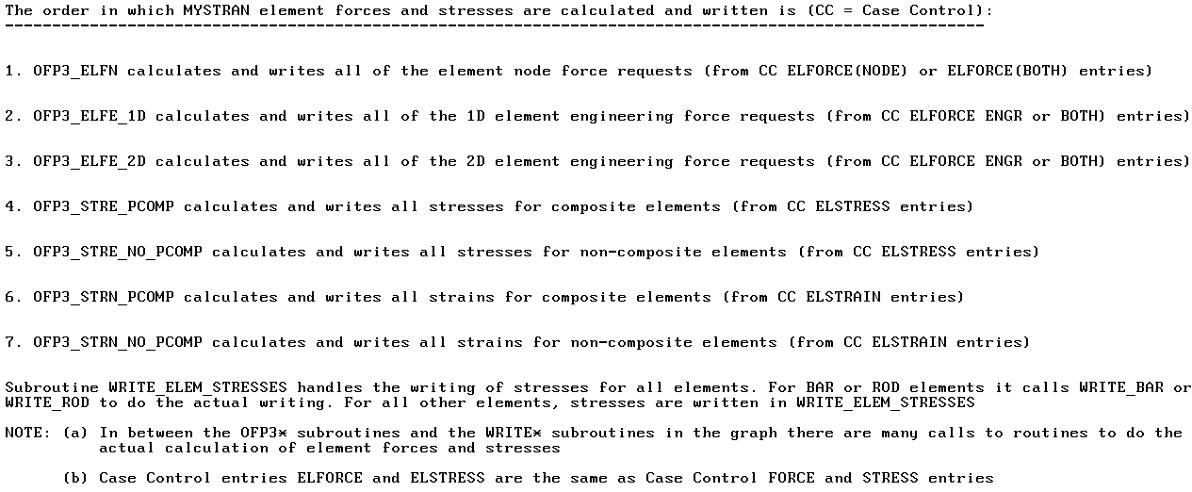
Major subroutines called for the calculation and writing
of MYSTRAN element forces and stresses

